Slide 1

TBA2104 Predictive Analytics Order Brushing Predictive System Group 10
Choo Shu Min (A0227117L)
Wong Kwok Cheong (A0211279H)
Yeoh Amy (A0227095B)

Slide 2
TABLE OF CONTENTS
Introduction
Process Overview
Data Download/Preparation
Data Modelling, Analysis and Findings
Logistic Regression, Support Vector Machine, Random Forest, Naives Bayes
Conclusion

Slide 3
Introduction
Notes:
Introduce what this project is about.
Describe the business domain and the data used.

Slide 4
Background: Order Brushing
Definition: Generating fake orders in an attempt to boost their shop’s rating and can be done by placing/and or completing a fake order through a third party and posting a positive rating or review to artificially increase the credibility of the item purchased.

Slide 5
Background: Order Brushing
Characteristics:
Surplus of orders for same products over short period of time compared to the past
Buyers identified as fraudulent users and/or signs of fraudulent transactional behavior
The seller sends their products to user/non-user who do not place an order

Slide 6
Order Brushing Predictive System
To identify categories with a larger number of sellers that attempt to create fake orders for boosting sales on e-commerce platforms.
Highlighted categories will be noted down for further actions to protect the credibility of the other sellers and the platform.

Slide 7
Overview: Data Analytics Process

Slide 8
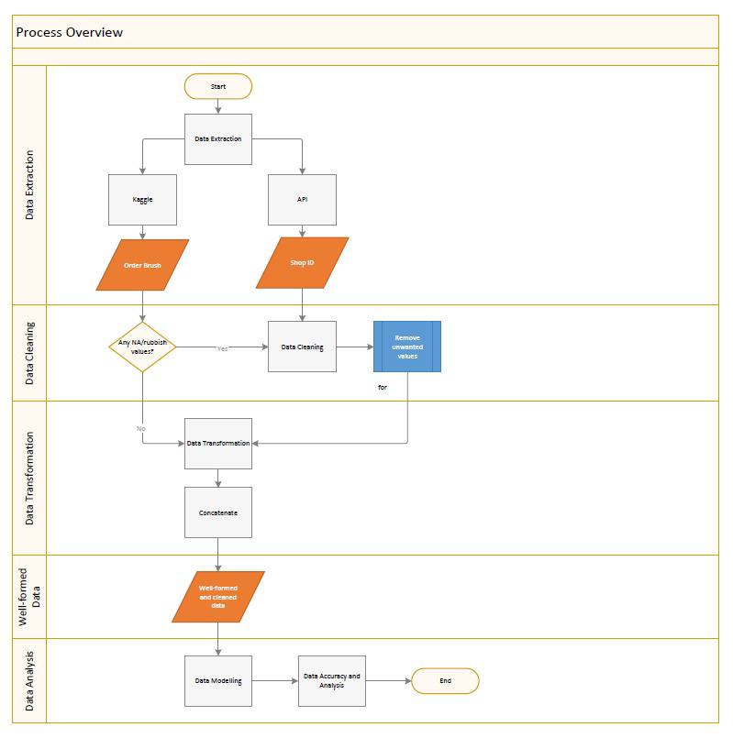
Process Overview
Data Extraction
Data Cleaning/Transformation
Data Analysis

Slide 9
Data Download/Extraction
Data Source: Kaggle and API
Dataset 1: Order Brush
Dataset 2: ShopID
Notes:
Introduce what this project is about.
Describe the business domain and the data used.

Slide 10
Data Download: Kaggle
Data source:
https://www.kaggle.com/datasets/davydev/shopee-code-league-20?resource=download

Slide 11
Data Download: API
Use of API to extract data from Shopee

Slide 12
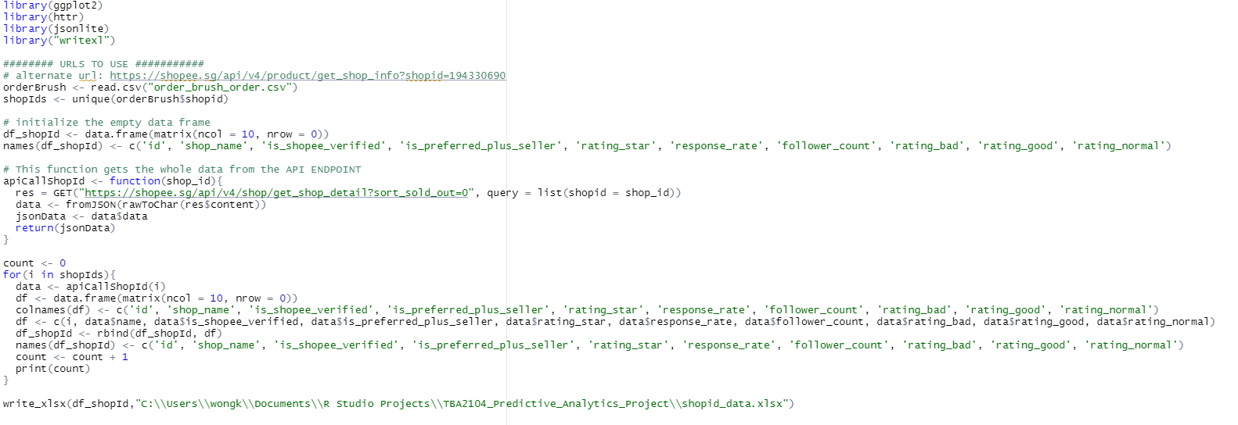
Data Download: API

Slide 13
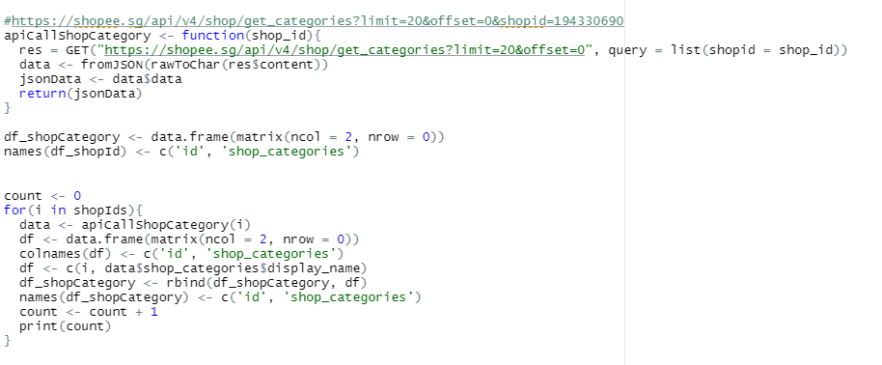
Data Download: API

Slide 14
Data Preparation
Data cleaning and transformation process
Notes:
• Describe the data preparation process such as data cleaning (if applicable).
Data Transformation
Normalize data
Discretize/aggregate data
Construct new attributes
Data Reduction
Reduce no. of variables
Reduce number of cases
Balance skewed data

Slide 15
Data Cleaning

Slide 16
Data Cleaning: Order Brush Dataset
Dataset is checked for:
NA values
Data accuracy
Dataset downloaded is of quality, hence not much cleaning required
Notes:
Data Extraction/consolidation > Data cleaning > Data transformation > Data reduction > well formed data > data analysis
Input missing values/reduce noise in data/eliminate inconsistencies
Omit NA from the dataset

Slide 17
Data Cleaning: ShopID Dataset
Data are cleaned using excel.
Ensure values are within the following range and remove the rest:
Rating Stars: within 1 - 5
Shop Response: between 1 to 100
Preferred: Yes or No
Verified: True or false
Notes:
Data Extraction/consolidation > Data cleaning > Data transformation > Data reduction > well formed data > data analysis
Input missing values/reduce noise in data/eliminate inconsistencies
Omit NA from the dataset

Slide 18
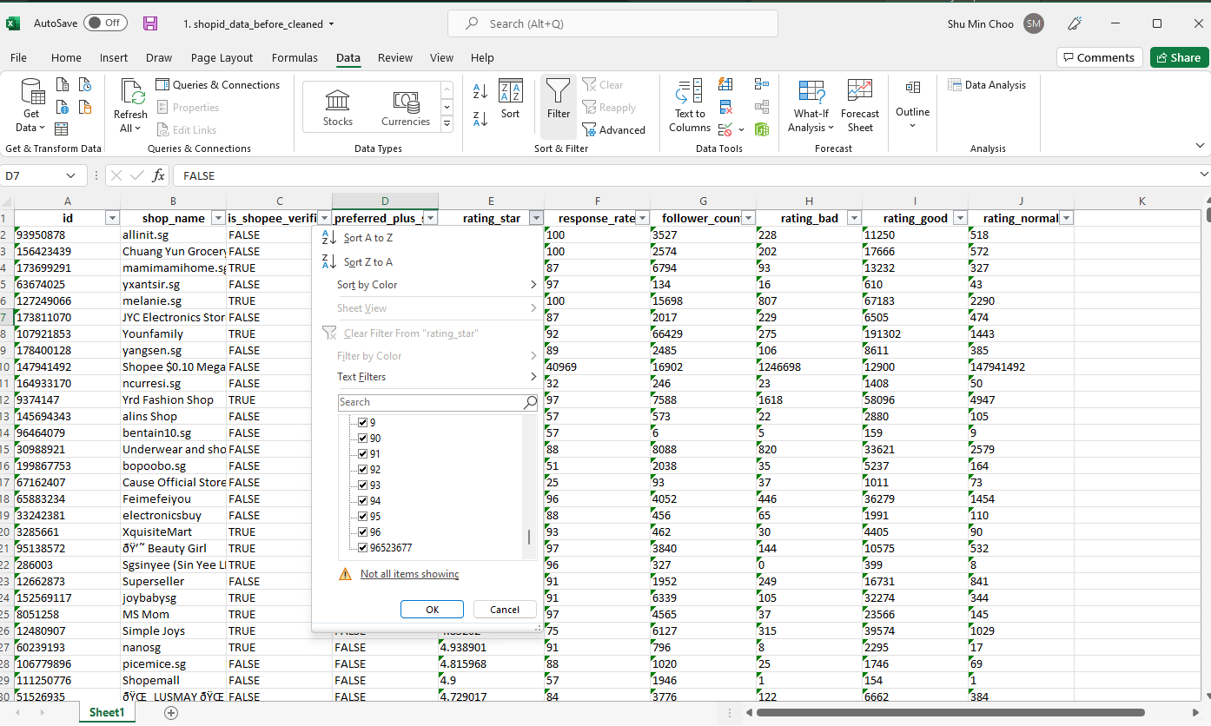
Data Cleaning: ShopID Dataset
Value should be true or false
Notes:
Data Extraction/consolidation > Data cleaning > Data transformation > Data reduction > well formed data > data analysis
Input missing values/reduce noise in data/eliminate inconsistencies
Omit NA from the dataset

Slide 19
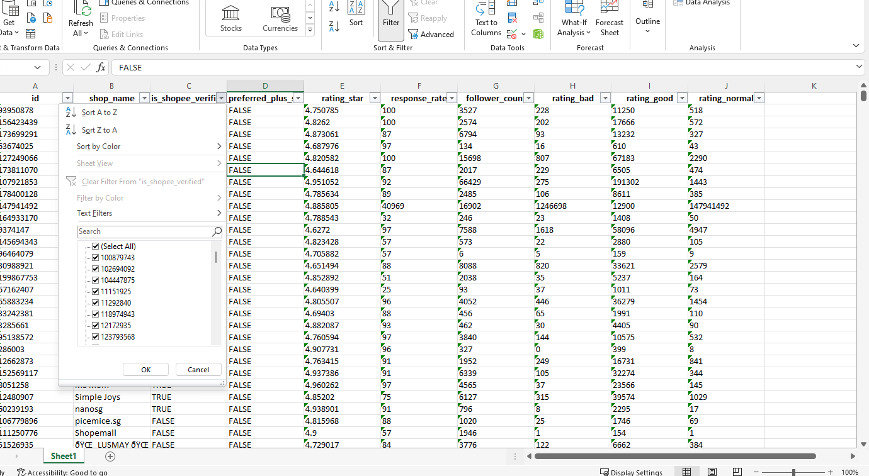
Data Cleaning: ShopID Dataset
Value should be true or false
Notes:
Data Extraction/consolidation > Data cleaning > Data transformation > Data reduction > well formed data > data analysis
Input missing values/reduce noise in data/eliminate inconsistencies
Omit NA from the dataset

Slide 20
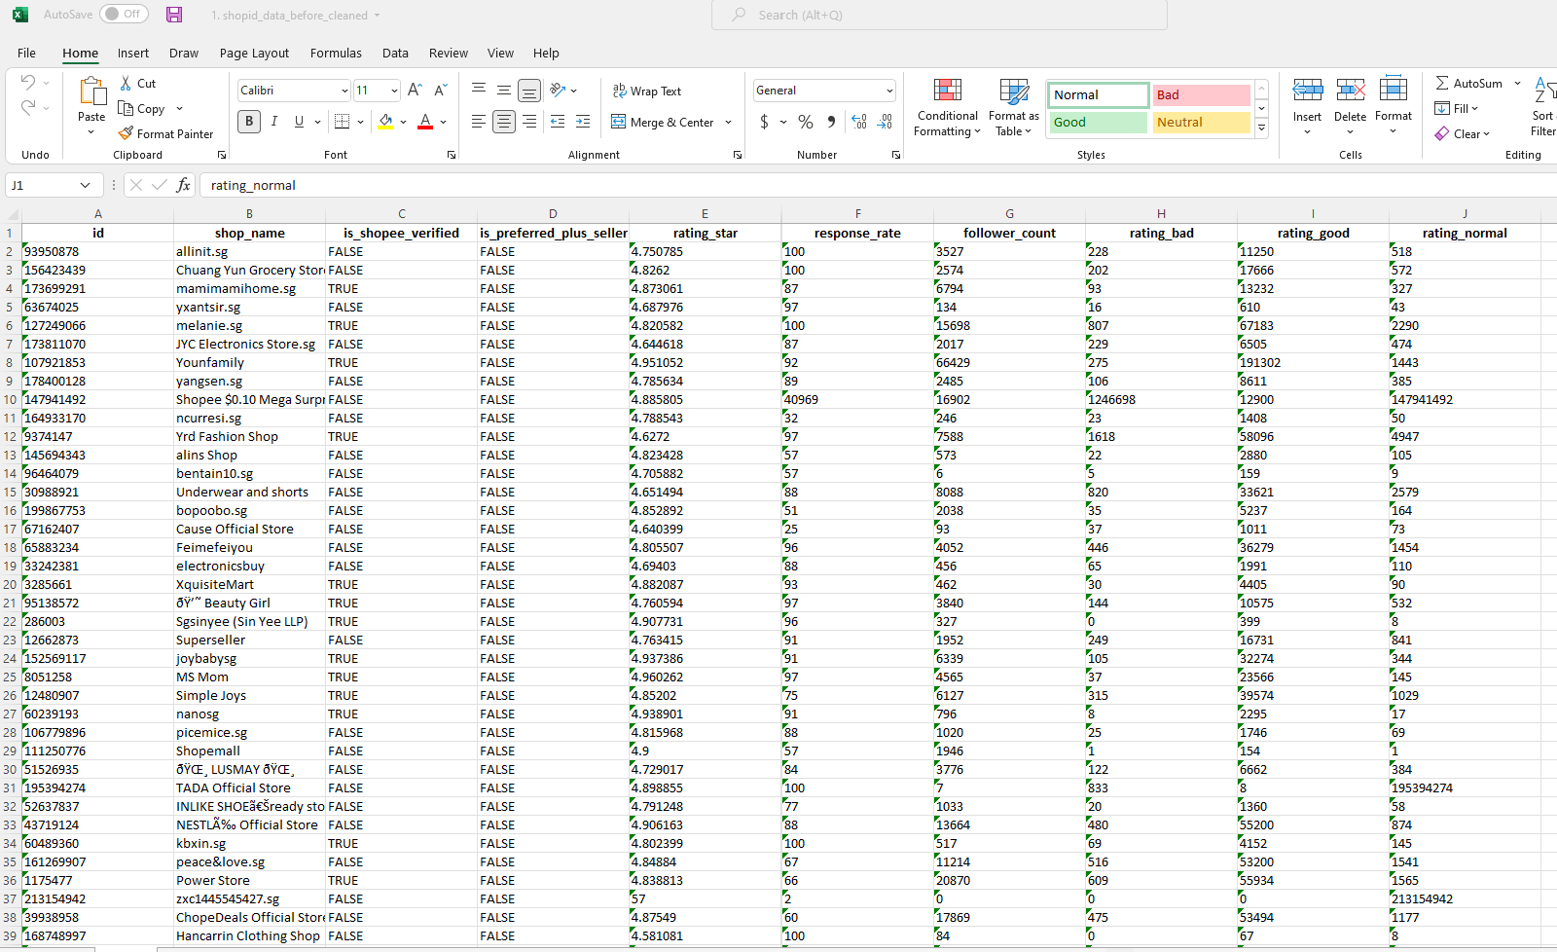
Data Cleaning: ShopID Dataset
Value should be within 1 to 100
Notes:
Data Extraction/consolidation > Data cleaning > Data transformation > Data reduction > well formed data > data analysis
Input missing values/reduce noise in data/eliminate inconsistencies
Omit NA from the dataset

Slide 21
Data Transformation

Slide 22
Data Transformation: Order Brush Dataset
Loading dataset into R
Concatenate 'shopid' and 'userid'
Set 'event_time' in date and time format
Arrange 'shopid_userid' by ascending order
Identify duplicated values in 'shopid_userid'
Identify 'shopid_userid' with multiple orders place
Identify frequency of order for the 'shopid_userid'
Identify those with more than 3 orders
Calculate the time difference between each row (in seconds) and assign zero to first row
Identify orders placed within an hour (3600 seconds)
1 - order place within an hour
0 - order place not within an hour
Calculate the frequency of 'shopid_userid'
Identify order with frequency of more than or equal to 2
1 - No order brushing
Order brusher based on shopID obtained
2 or more - order brushing
Notes:
Data Extraction/consolidation > Data cleaning > Data transformation > Data reduction > well formed data > data analysis
Input missing values/reduce noise in data/eliminate inconsistencies
Omit NA from the dataset
Loading dataset into R
concatenate shopid and userid
set event_time as date and time format
order the column shopid_userid by ascending order
find duplicated shopid_userid
find those shopid_userid that with multiple orders place
find frequency of order for the shopid_userid
find those with more than 3 orders
find the time different between each row (in seconds), assign zero to first row
identify those order that place within an hour (3600 seconds)
find the frequency of shopid_userid
find order with frequency more than equal to 2
this is because those with frequency 1 should not be brushing
Results
1 mean order place within an hour
0 mean order place not wihitn an hour

Slide 23
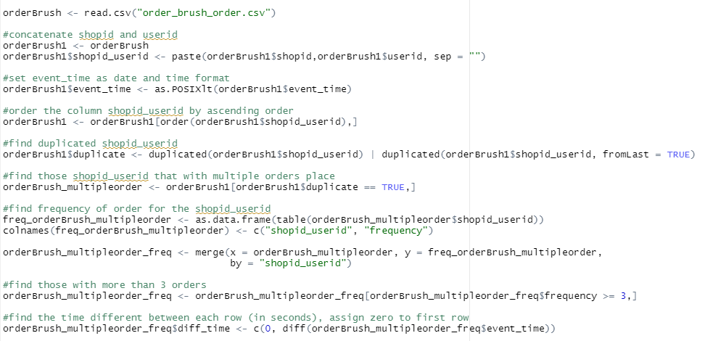
Order Brush Dataset: R codes
Notes:
Data Extraction/consolidation > Data cleaning > Data transformation > Data reduction > well formed data > data analysis
Input missing values/reduce noise in data/eliminate inconsistencies
Omit NA from the dataset

Slide 24
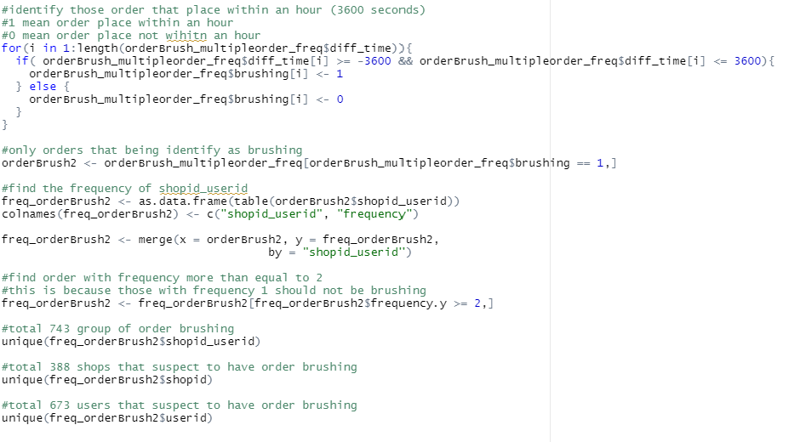
Order Brush Dataset: R codes
Notes:
Data Extraction/consolidation > Data cleaning > Data transformation > Data reduction > well formed data > data analysis
Input missing values/reduce noise in data/eliminate inconsistencies
Omit NA from the dataset

Slide 25
Well-formed data

Slide 26
Combining Order Brush and ShopID Dataset
The Order Brush and ShopID dataset are combined into one with the help of xlookup() function
With the cleaned and well-formed data, it will be ready for further analysis:
Logistic Regression
Support Vector Machine

Slide 27
Data Pre-processing: Order Brush and ShopID Dataset
Dataset loaded into r
Check for classification and reclass
Split the data into train (75%) & test (25%)
SMOTE

Slide 28
Data Modelling, Analysis and Findings
Logistic Regression
Support Vector Machine
Random Forest
Notes:
Describe the various data exploration tasks performed (e.g. data visualization,
descriptive analysis, etc).
Describe the modeling techniques used (e.g. regression, classification,
clustering).
• Compare and contrast different modeling algorithms.
• Explain and discuss the experimental results.
• Discuss any limitations of the approach.

Slide 29
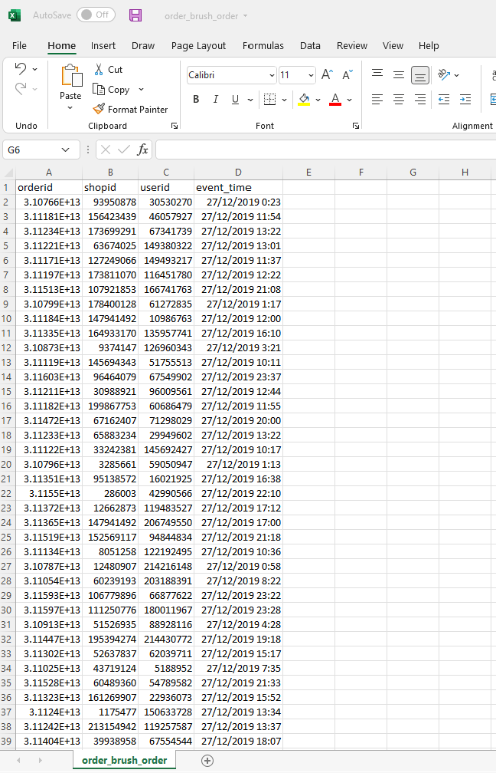
Overview
Orderbrush Dataset Contains:
OrderID
ShopID
UserID
Event_time

Slide 30
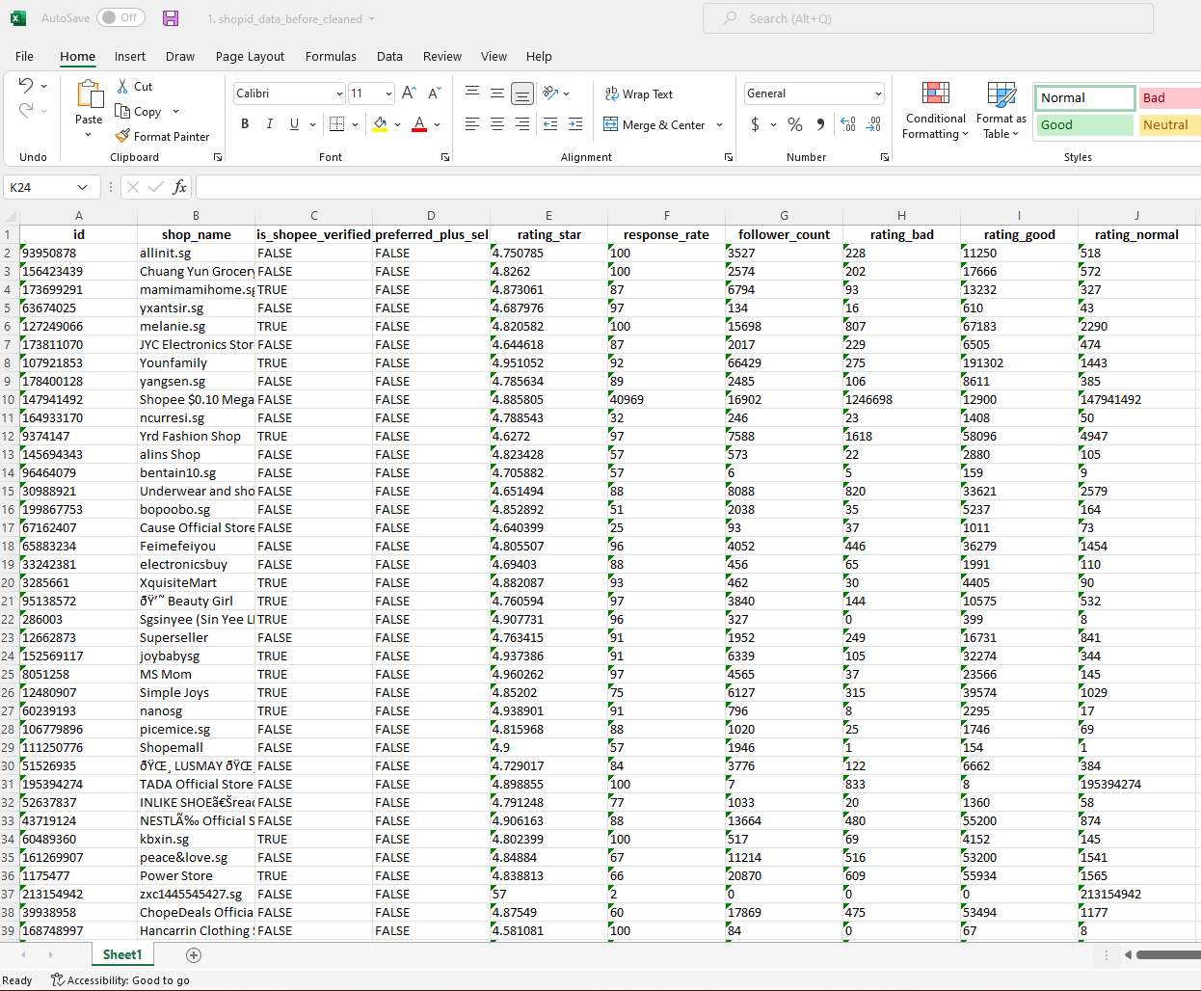
Overview
ShopID Dataset Contains:
ShopID
Shop Name
If shop is verified*
If shop is preferred**
Shop Rating
On a scale of 1 to 5, 5 being the best
*Verified refer to account verification with contact number/email
**To qualify for ‘preferred’, seller has to meet a certain criteria and invited by Shopee

Slide 31
Overview
ShopID Dataset Contains:
Shop response rate*
Shop follower count
Total no. of Bad Ratings
Total no. of Good Ratings
Total no. of Normal Ratings
*Response rate refers to seller’s chat response rate to buyer

Slide 32
Data Visualization
16,970 shops in dataset
387/16,970 identified as order brusher
8% of shop is verified
None of the shop is under preferred seller programme
Therefore we will omit out the column
Notes:
Shopee preferred sellers:
Shopee Preferred Sellers are a group of specially selected sellers who have proved to be able to provide an enhanced shopping experience. When you buy from a Preferred Seller, you can be sure that they uphold these excellence standards:
Have high shop ratings
Provide good customer service
Ship out orders quickly and efficiently
Criteria:
https://seller.shopee.sg/edu/article/2610

Slide 33
Data Visualization
Bulk of data with less than 5000 followers (96.3%)
388 shops with order brushing (2.3%)
Notes:
Shopee preferred sellers:
Shopee Preferred Sellers are a group of specially selected sellers who have proved to be able to provide an enhanced shopping experience. When you buy from a Preferred Seller, you can be sure that they uphold these excellence standards:
Have high shop ratings
Provide good customer service
Ship out orders quickly and efficiently
Criteria:
https://seller.shopee.sg/edu/article/2610

Slide 34
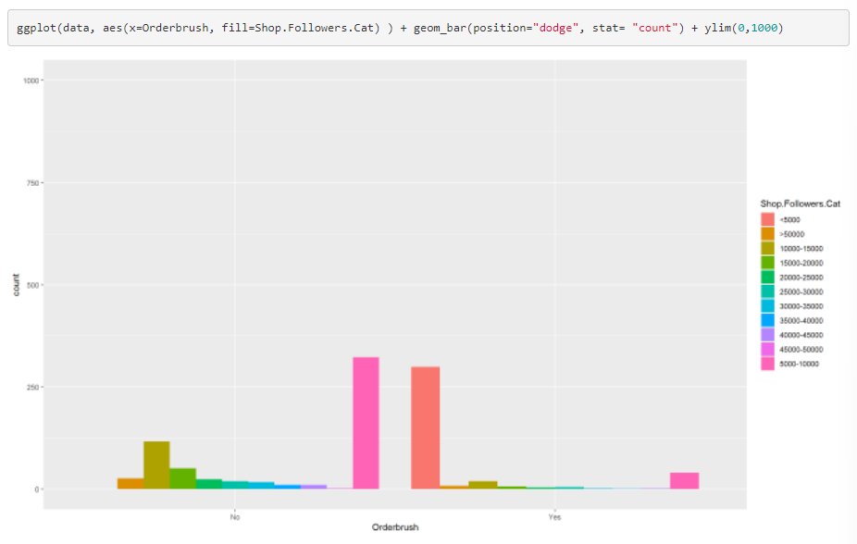
Data Visualization
Notes:
Shopee preferred sellers:
Shopee Preferred Sellers are a group of specially selected sellers who have proved to be able to provide an enhanced shopping experience. When you buy from a Preferred Seller, you can be sure that they uphold these excellence standards:
Have high shop ratings
Provide good customer service
Ship out orders quickly and efficiently
Criteria:
https://seller.shopee.sg/edu/article/2610

Slide 35
Data Visualization
Notes:
Shopee preferred sellers:
Shopee Preferred Sellers are a group of specially selected sellers who have proved to be able to provide an enhanced shopping experience. When you buy from a Preferred Seller, you can be sure that they uphold these excellence standards:
Have high shop ratings
Provide good customer service
Ship out orders quickly and efficiently
Criteria:
https://seller.shopee.sg/edu/article/2610

Slide 36
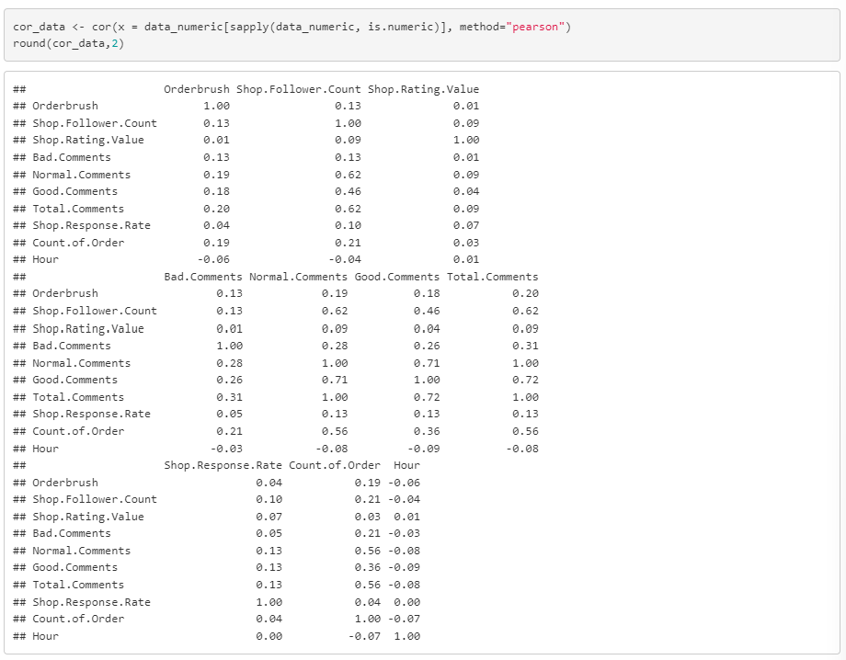
Correlation Plot
Notes:
Shopee preferred sellers:
Shopee Preferred Sellers are a group of specially selected sellers who have proved to be able to provide an enhanced shopping experience. When you buy from a Preferred Seller, you can be sure that they uphold these excellence standards:
Have high shop ratings
Provide good customer service
Ship out orders quickly and efficiently
Criteria:
https://seller.shopee.sg/edu/article/2610

Slide 37
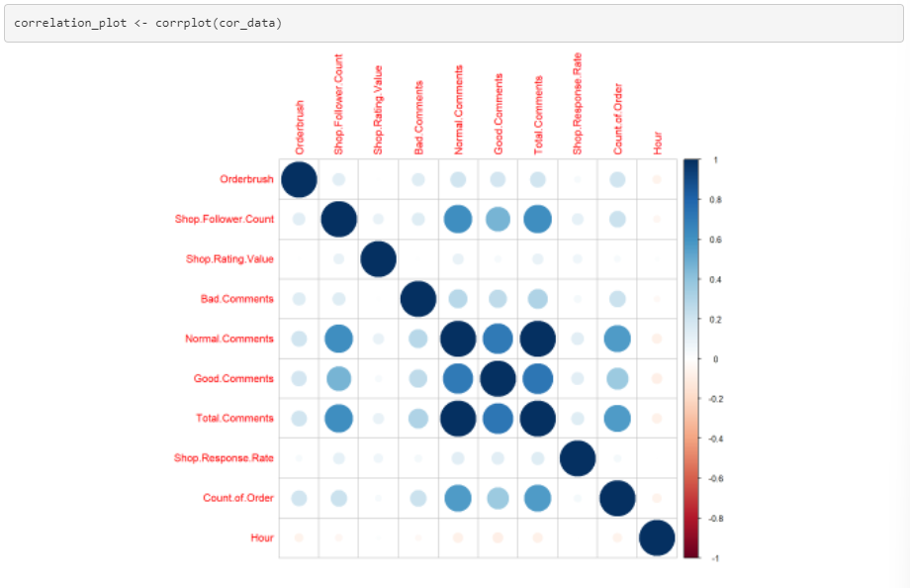
Correlation Plot
Notes:
Shopee preferred sellers:
Shopee Preferred Sellers are a group of specially selected sellers who have proved to be able to provide an enhanced shopping experience. When you buy from a Preferred Seller, you can be sure that they uphold these excellence standards:
Have high shop ratings
Provide good customer service
Ship out orders quickly and efficiently
Criteria:
https://seller.shopee.sg/edu/article/2610

Slide 38
Logistic Regression

Slide 39
Logistic Regression
Used to predict quantitative (any variables where the data represent amounts (e.g. height, weight, or age)) response Y
Assumes that there is a approximately a linear relationship between X and Y

Slide 40
Logistic Regression: First Method
Receiver Operator Characteristic (ROC) and Area Under the Curve (AUC) are typical performance measurements for a binary classifier.

Slide 41
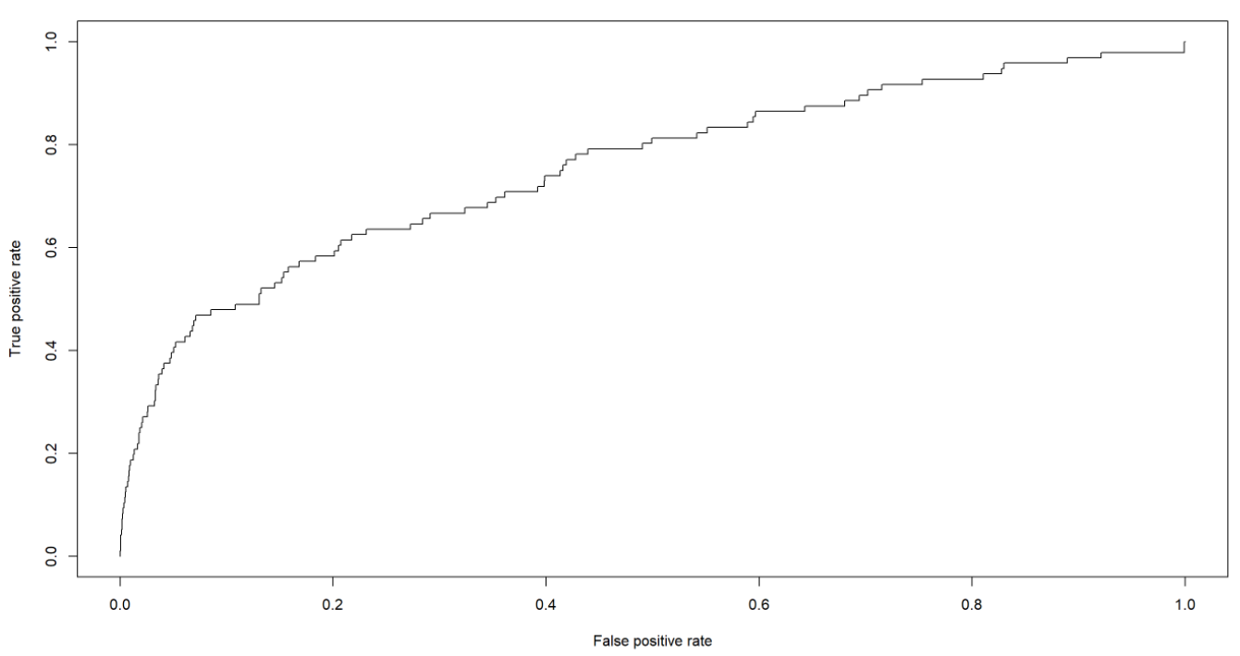
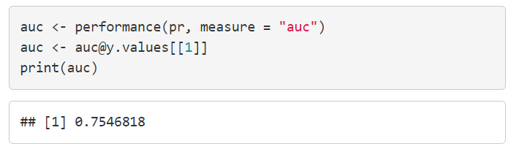
Logistic Regression: Model Accuracy
ROC curve closer to the top-left corner indicate a better performance.
AUC between 0.5 to 1 mean the model with good predictive ability.

Slide 42
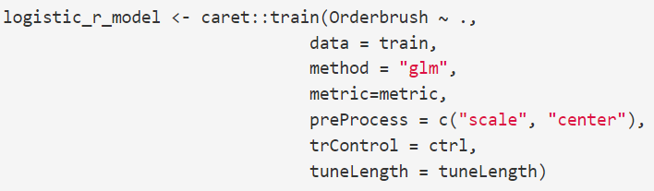
Logistic Regression: Second Method
Performed data tuning and pre-processing.
We used 'glm' method which specifies that we will fit a generalized linear model.

Slide 43
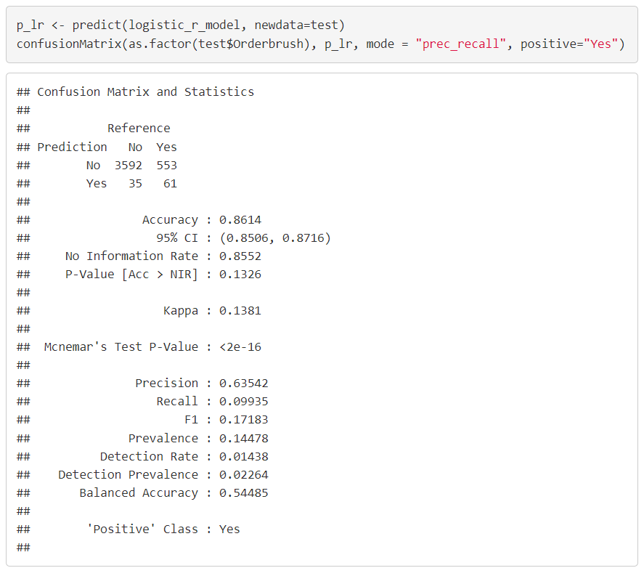
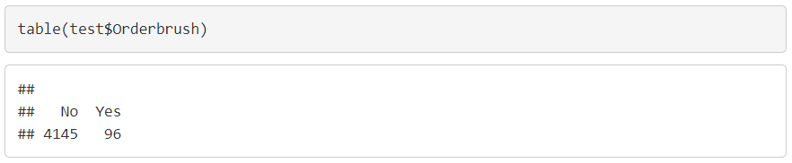
Logistic Regression: Model Accuracy
Out of 96 "Yes", the model predicted 61 "Yes".

Slide 44
Support Vector Machines
Notes:
Logistic
Load dataset into R
Check for classification and reclassify accordingly
Create train and test dataset

Slide 45
Support Vector Machines
Extension of maximal margin classifier to accommodate non-linear class boundaries
Intended for binary classification setting

Slide 46
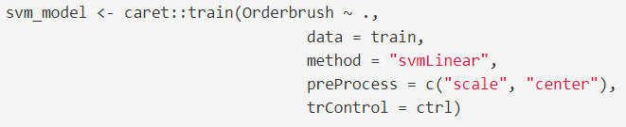
Support Vector Machines: Linear Classifier
The variables are normalized to make their scale comparable.
Tuning parameter C (Cost) is to determine the possible misclassifications. We used the default C = 1.

Slide 47
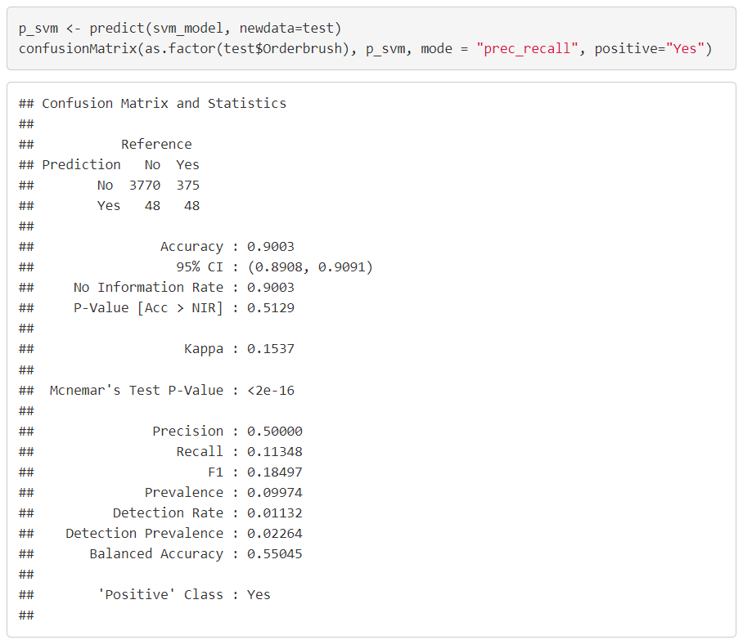
Support Vector Machines: Model Accuracy
Out of 96 "Yes", the model predicted 48 "Yes".

Slide 48
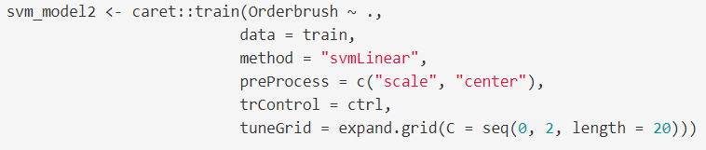
Support Vector Machines: Linear with Choice of Cost
Computed SVM for a grid values of C and choose automatically the final model for predictions.

Slide 49
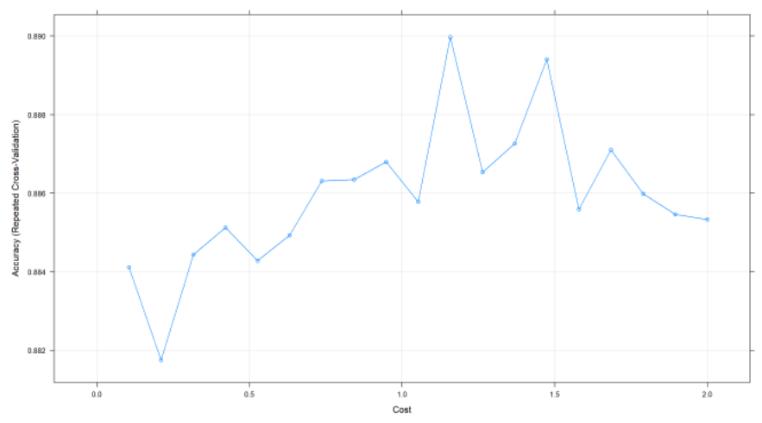
Support Vector Machines: Model Accuracy
The best tune choice of
C = 0.2105263

Slide 50
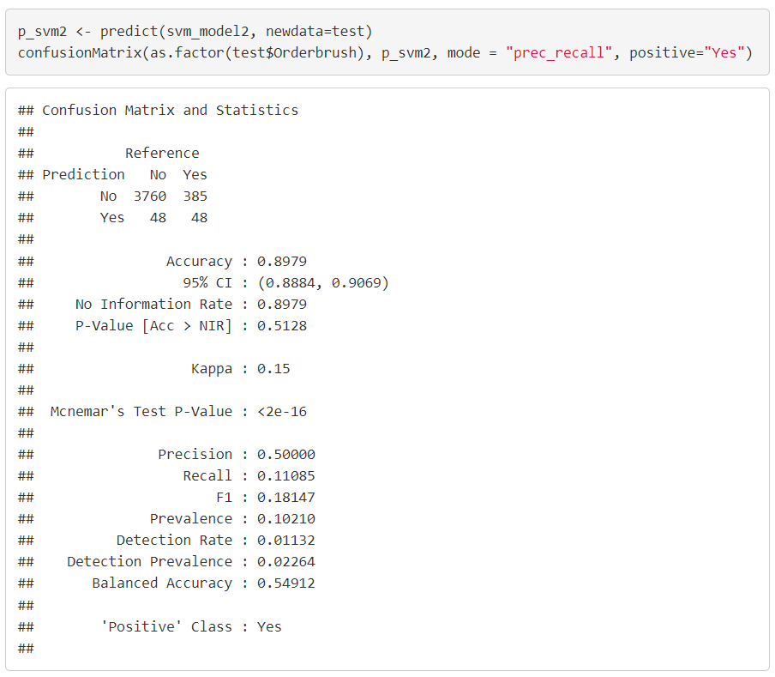
Support Vector Machines: Model Accuracy
Out of 96 "Yes", the model predicted 48 "Yes".

Slide 51
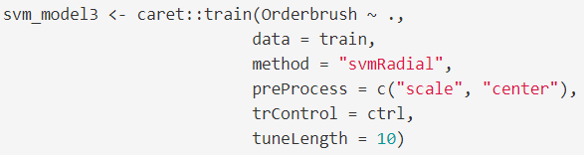
Support Vector Machines: Non-Linear Kernel (Radial)

Slide 52

Support Vector Machines: Model Accuracy
Out of 96 "Yes", the model predicted 70 "Yes".

Slide 53
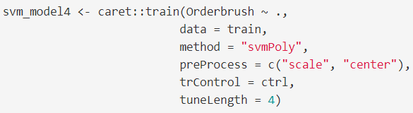
Support Vector Machines: Non-Linear Kernel (Polynomial)

Slide 54
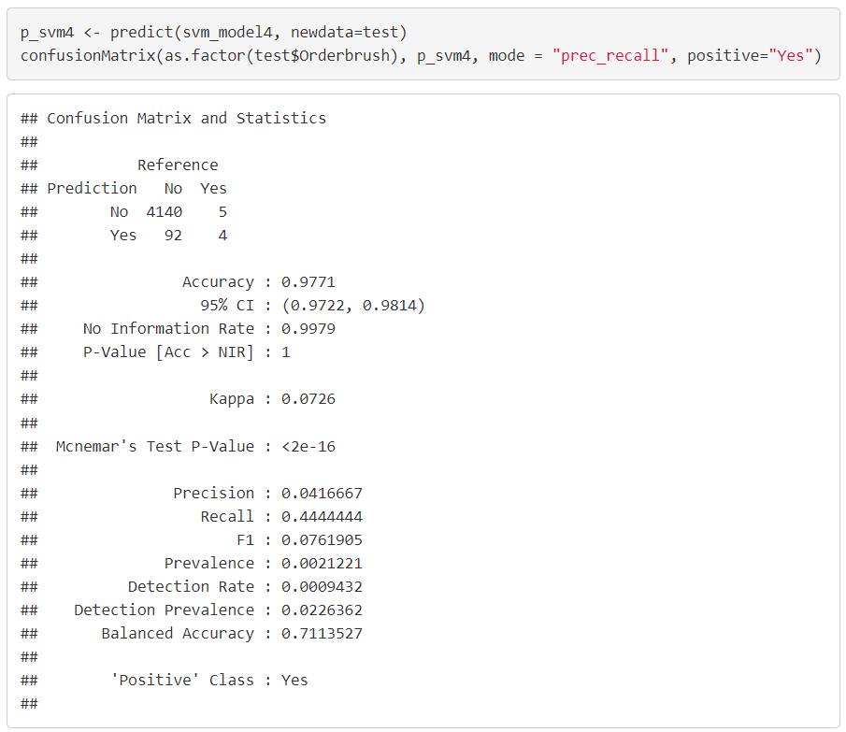
Support Vector Machines: Model Accuracy
Out of 96 "Yes", the model predicted 70 "Yes".

Slide 55
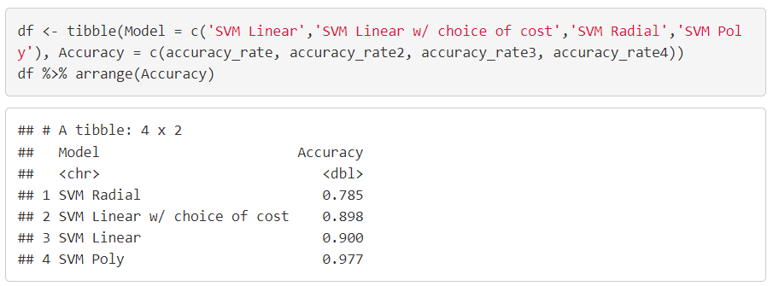
Support Vector Machines: Model Accuracy Comparison
It shown that the SVM classifier using non-linear kernel Radial gives a better result compared to the linear model.

Slide 56
Random Forest

Slide 57
Random Forest
Provides an improvement over bagged trees by way of a small tweak that decorrelates the trees
Each time a tree is split, a random sample of m predictors is taken at each split
Notes:
#concatenate shopid and userid
orderBrush1 <- orderBrush
orderBrush1$shopid_userid <- paste(orderBrush1$shopid,orderBrush1$userid, sep = "")
#set event_time as date and time format
orderBrush1$event_time <- as.POSIXlt(orderBrush1$event_time)
#order the column shopid_userid by ascending order
orderBrush1 <- orderBrush1[order(orderBrush1$shopid_userid),]
#find duplicated shopid_userid
orderBrush1$duplicate <- duplicated(orderBrush1$shopid_userid) | duplicated(orderBrush1$shopid_userid, fromLast = TRUE)
#find those shopid_userid that with multiple orders place
orderBrush_multipleorder <- orderBrush1[orderBrush1$duplicate == TRUE,]
#find frequency of order for the shopid_userid
freq_orderBrush_multipleorder <- as.data.frame(table(orderBrush_multipleorder$shopid_userid))
colnames(freq_orderBrush_multipleorder) <- c("shopid_userid", "frequency")
orderBrush_multipleorder_freq <- merge(x = orderBrush_multipleorder, y = freq_orderBrush_multipleorder,
by = "shopid_userid")
#find those with more than 3 orders
orderBrush_multipleorder_freq <- orderBrush_multipleorder_freq[orderBrush_multipleorder_freq$frequency >= 3,]
#find the time different between each row (in seconds), assign zero to first row
orderBrush_multipleorder_freq$diff_time <- c(0, diff(orderBrush_multipleorder_freq$event_time))
#identify those order that place within an hour (3600 seconds)
#1 mean order place within an hour
#0 mean order place not wihitn an hour
for(i in 1:length(orderBrush_multipleorder_freq$diff_time)){
if( orderBrush_multipleorder_freq$diff_time[i] >= -3600 && orderBrush_multipleorder_freq$diff_time[i] <= 3600){
orderBrush_multipleorder_freq$brushing[i] <- 1
} else {
orderBrush_multipleorder_freq$brushing[i] <- 0
}
}
#only orders that being identify as brushing
orderBrush2 <- orderBrush_multipleorder_freq[orderBrush_multipleorder_freq$brushing == 1,]
#find the frequency of shopid_userid
freq_orderBrush2 <- as.data.frame(table(orderBrush2$shopid_userid))
colnames(freq_orderBrush2) <- c("shopid_userid", "frequency")
freq_orderBrush2 <- merge(x = orderBrush2, y = freq_orderBrush2,
by = "shopid_userid")
#find order with frequency more than equal to 2
#this is because those with frequency 1 should not be brushing
freq_orderBrush2 <- freq_orderBrush2[freq_orderBrush2$frequency.y >= 2,]
#total 743 group of order brushing
unique(freq_orderBrush2$shopid_userid)
#total 388 shops that suspect to have order brushing
unique(freq_orderBrush2$shopid)
#total 673 users that suspect to have order brushing
unique(freq_orderBrush2$userid)

Slide 58
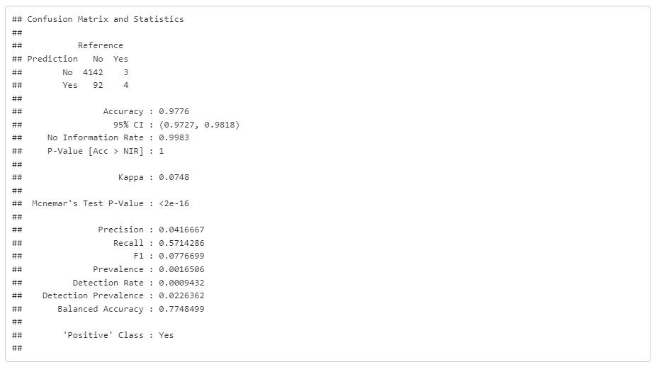
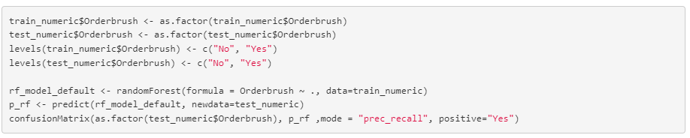
Random Forest: Default – Train Test
Notes:
#concatenate shopid and userid
orderBrush1 <- orderBrush
orderBrush1$shopid_userid <- paste(orderBrush1$shopid,orderBrush1$userid, sep = "")
#set event_time as date and time format
orderBrush1$event_time <- as.POSIXlt(orderBrush1$event_time)
#order the column shopid_userid by ascending order
orderBrush1 <- orderBrush1[order(orderBrush1$shopid_userid),]
#find duplicated shopid_userid
orderBrush1$duplicate <- duplicated(orderBrush1$shopid_userid) | duplicated(orderBrush1$shopid_userid, fromLast = TRUE)
#find those shopid_userid that with multiple orders place
orderBrush_multipleorder <- orderBrush1[orderBrush1$duplicate == TRUE,]
#find frequency of order for the shopid_userid
freq_orderBrush_multipleorder <- as.data.frame(table(orderBrush_multipleorder$shopid_userid))
colnames(freq_orderBrush_multipleorder) <- c("shopid_userid", "frequency")
orderBrush_multipleorder_freq <- merge(x = orderBrush_multipleorder, y = freq_orderBrush_multipleorder,
by = "shopid_userid")
#find those with more than 3 orders
orderBrush_multipleorder_freq <- orderBrush_multipleorder_freq[orderBrush_multipleorder_freq$frequency >= 3,]
#find the time different between each row (in seconds), assign zero to first row
orderBrush_multipleorder_freq$diff_time <- c(0, diff(orderBrush_multipleorder_freq$event_time))
#identify those order that place within an hour (3600 seconds)
#1 mean order place within an hour
#0 mean order place not wihitn an hour
for(i in 1:length(orderBrush_multipleorder_freq$diff_time)){
if( orderBrush_multipleorder_freq$diff_time[i] >= -3600 && orderBrush_multipleorder_freq$diff_time[i] <= 3600){
orderBrush_multipleorder_freq$brushing[i] <- 1
} else {
orderBrush_multipleorder_freq$brushing[i] <- 0
}
}
#only orders that being identify as brushing
orderBrush2 <- orderBrush_multipleorder_freq[orderBrush_multipleorder_freq$brushing == 1,]
#find the frequency of shopid_userid
freq_orderBrush2 <- as.data.frame(table(orderBrush2$shopid_userid))
colnames(freq_orderBrush2) <- c("shopid_userid", "frequency")
freq_orderBrush2 <- merge(x = orderBrush2, y = freq_orderBrush2,
by = "shopid_userid")
#find order with frequency more than equal to 2
#this is because those with frequency 1 should not be brushing
freq_orderBrush2 <- freq_orderBrush2[freq_orderBrush2$frequency.y >= 2,]
#total 743 group of order brushing
unique(freq_orderBrush2$shopid_userid)
#total 388 shops that suspect to have order brushing
unique(freq_orderBrush2$shopid)
#total 673 users that suspect to have order brushing
unique(freq_orderBrush2$userid)

Slide 59
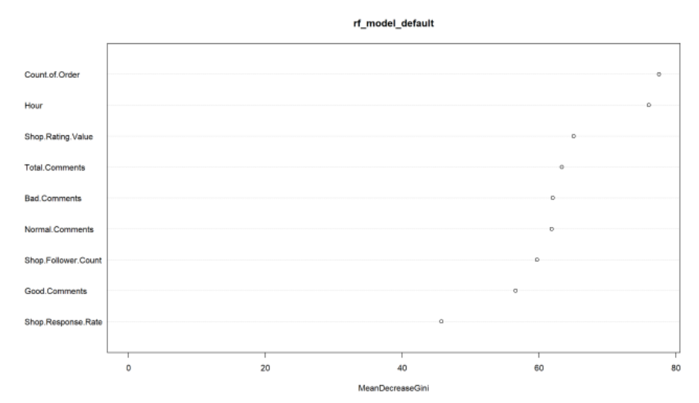
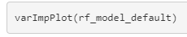
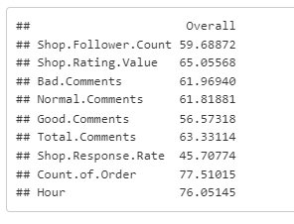
Random Forest: Default – Train Test
Notes:
#concatenate shopid and userid
orderBrush1 <- orderBrush
orderBrush1$shopid_userid <- paste(orderBrush1$shopid,orderBrush1$userid, sep = "")
#set event_time as date and time format
orderBrush1$event_time <- as.POSIXlt(orderBrush1$event_time)
#order the column shopid_userid by ascending order
orderBrush1 <- orderBrush1[order(orderBrush1$shopid_userid),]
#find duplicated shopid_userid
orderBrush1$duplicate <- duplicated(orderBrush1$shopid_userid) | duplicated(orderBrush1$shopid_userid, fromLast = TRUE)
#find those shopid_userid that with multiple orders place
orderBrush_multipleorder <- orderBrush1[orderBrush1$duplicate == TRUE,]
#find frequency of order for the shopid_userid
freq_orderBrush_multipleorder <- as.data.frame(table(orderBrush_multipleorder$shopid_userid))
colnames(freq_orderBrush_multipleorder) <- c("shopid_userid", "frequency")
orderBrush_multipleorder_freq <- merge(x = orderBrush_multipleorder, y = freq_orderBrush_multipleorder,
by = "shopid_userid")
#find those with more than 3 orders
orderBrush_multipleorder_freq <- orderBrush_multipleorder_freq[orderBrush_multipleorder_freq$frequency >= 3,]
#find the time different between each row (in seconds), assign zero to first row
orderBrush_multipleorder_freq$diff_time <- c(0, diff(orderBrush_multipleorder_freq$event_time))
#identify those order that place within an hour (3600 seconds)
#1 mean order place within an hour
#0 mean order place not wihitn an hour
for(i in 1:length(orderBrush_multipleorder_freq$diff_time)){
if( orderBrush_multipleorder_freq$diff_time[i] >= -3600 && orderBrush_multipleorder_freq$diff_time[i] <= 3600){
orderBrush_multipleorder_freq$brushing[i] <- 1
} else {
orderBrush_multipleorder_freq$brushing[i] <- 0
}
}
#only orders that being identify as brushing
orderBrush2 <- orderBrush_multipleorder_freq[orderBrush_multipleorder_freq$brushing == 1,]
#find the frequency of shopid_userid
freq_orderBrush2 <- as.data.frame(table(orderBrush2$shopid_userid))
colnames(freq_orderBrush2) <- c("shopid_userid", "frequency")
freq_orderBrush2 <- merge(x = orderBrush2, y = freq_orderBrush2,
by = "shopid_userid")
#find order with frequency more than equal to 2
#this is because those with frequency 1 should not be brushing
freq_orderBrush2 <- freq_orderBrush2[freq_orderBrush2$frequency.y >= 2,]
#total 743 group of order brushing
unique(freq_orderBrush2$shopid_userid)
#total 388 shops that suspect to have order brushing
unique(freq_orderBrush2$shopid)
#total 673 users that suspect to have order brushing
unique(freq_orderBrush2$userid)

Slide 60
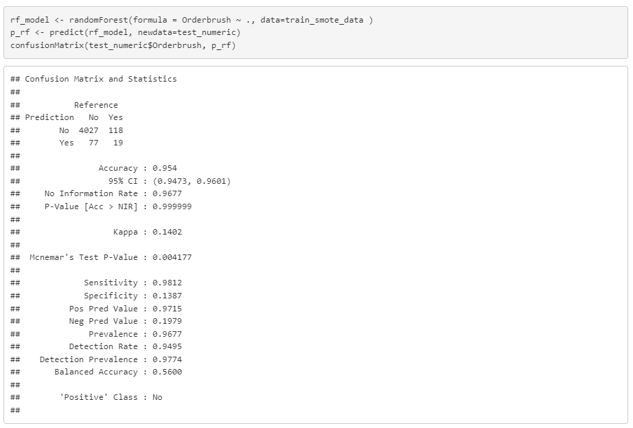
Random Forest: SMOTE
Notes:
#concatenate shopid and userid
orderBrush1 <- orderBrush
orderBrush1$shopid_userid <- paste(orderBrush1$shopid,orderBrush1$userid, sep = "")
#set event_time as date and time format
orderBrush1$event_time <- as.POSIXlt(orderBrush1$event_time)
#order the column shopid_userid by ascending order
orderBrush1 <- orderBrush1[order(orderBrush1$shopid_userid),]
#find duplicated shopid_userid
orderBrush1$duplicate <- duplicated(orderBrush1$shopid_userid) | duplicated(orderBrush1$shopid_userid, fromLast = TRUE)
#find those shopid_userid that with multiple orders place
orderBrush_multipleorder <- orderBrush1[orderBrush1$duplicate == TRUE,]
#find frequency of order for the shopid_userid
freq_orderBrush_multipleorder <- as.data.frame(table(orderBrush_multipleorder$shopid_userid))
colnames(freq_orderBrush_multipleorder) <- c("shopid_userid", "frequency")
orderBrush_multipleorder_freq <- merge(x = orderBrush_multipleorder, y = freq_orderBrush_multipleorder,
by = "shopid_userid")
#find those with more than 3 orders
orderBrush_multipleorder_freq <- orderBrush_multipleorder_freq[orderBrush_multipleorder_freq$frequency >= 3,]
#find the time different between each row (in seconds), assign zero to first row
orderBrush_multipleorder_freq$diff_time <- c(0, diff(orderBrush_multipleorder_freq$event_time))
#identify those order that place within an hour (3600 seconds)
#1 mean order place within an hour
#0 mean order place not wihitn an hour
for(i in 1:length(orderBrush_multipleorder_freq$diff_time)){
if( orderBrush_multipleorder_freq$diff_time[i] >= -3600 && orderBrush_multipleorder_freq$diff_time[i] <= 3600){
orderBrush_multipleorder_freq$brushing[i] <- 1
} else {
orderBrush_multipleorder_freq$brushing[i] <- 0
}
}
#only orders that being identify as brushing
orderBrush2 <- orderBrush_multipleorder_freq[orderBrush_multipleorder_freq$brushing == 1,]
#find the frequency of shopid_userid
freq_orderBrush2 <- as.data.frame(table(orderBrush2$shopid_userid))
colnames(freq_orderBrush2) <- c("shopid_userid", "frequency")
freq_orderBrush2 <- merge(x = orderBrush2, y = freq_orderBrush2,
by = "shopid_userid")
#find order with frequency more than equal to 2
#this is because those with frequency 1 should not be brushing
freq_orderBrush2 <- freq_orderBrush2[freq_orderBrush2$frequency.y >= 2,]
#total 743 group of order brushing
unique(freq_orderBrush2$shopid_userid)
#total 388 shops that suspect to have order brushing
unique(freq_orderBrush2$shopid)
#total 673 users that suspect to have order brushing
unique(freq_orderBrush2$userid)

Slide 61
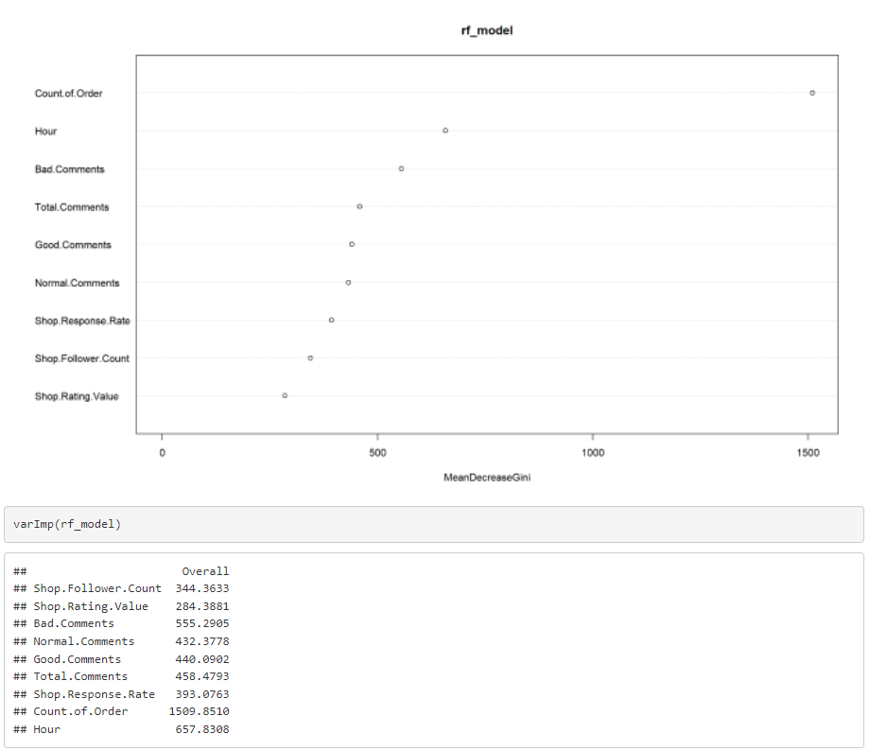
Random Forest: SMOTE
Notes:
#concatenate shopid and userid
orderBrush1 <- orderBrush
orderBrush1$shopid_userid <- paste(orderBrush1$shopid,orderBrush1$userid, sep = "")
#set event_time as date and time format
orderBrush1$event_time <- as.POSIXlt(orderBrush1$event_time)
#order the column shopid_userid by ascending order
orderBrush1 <- orderBrush1[order(orderBrush1$shopid_userid),]
#find duplicated shopid_userid
orderBrush1$duplicate <- duplicated(orderBrush1$shopid_userid) | duplicated(orderBrush1$shopid_userid, fromLast = TRUE)
#find those shopid_userid that with multiple orders place
orderBrush_multipleorder <- orderBrush1[orderBrush1$duplicate == TRUE,]
#find frequency of order for the shopid_userid
freq_orderBrush_multipleorder <- as.data.frame(table(orderBrush_multipleorder$shopid_userid))
colnames(freq_orderBrush_multipleorder) <- c("shopid_userid", "frequency")
orderBrush_multipleorder_freq <- merge(x = orderBrush_multipleorder, y = freq_orderBrush_multipleorder,
by = "shopid_userid")
#find those with more than 3 orders
orderBrush_multipleorder_freq <- orderBrush_multipleorder_freq[orderBrush_multipleorder_freq$frequency >= 3,]
#find the time different between each row (in seconds), assign zero to first row
orderBrush_multipleorder_freq$diff_time <- c(0, diff(orderBrush_multipleorder_freq$event_time))
#identify those order that place within an hour (3600 seconds)
#1 mean order place within an hour
#0 mean order place not wihitn an hour
for(i in 1:length(orderBrush_multipleorder_freq$diff_time)){
if( orderBrush_multipleorder_freq$diff_time[i] >= -3600 && orderBrush_multipleorder_freq$diff_time[i] <= 3600){
orderBrush_multipleorder_freq$brushing[i] <- 1
} else {
orderBrush_multipleorder_freq$brushing[i] <- 0
}
}
#only orders that being identify as brushing
orderBrush2 <- orderBrush_multipleorder_freq[orderBrush_multipleorder_freq$brushing == 1,]
#find the frequency of shopid_userid
freq_orderBrush2 <- as.data.frame(table(orderBrush2$shopid_userid))
colnames(freq_orderBrush2) <- c("shopid_userid", "frequency")
freq_orderBrush2 <- merge(x = orderBrush2, y = freq_orderBrush2,
by = "shopid_userid")
#find order with frequency more than equal to 2
#this is because those with frequency 1 should not be brushing
freq_orderBrush2 <- freq_orderBrush2[freq_orderBrush2$frequency.y >= 2,]
#total 743 group of order brushing
unique(freq_orderBrush2$shopid_userid)
#total 388 shops that suspect to have order brushing
unique(freq_orderBrush2$shopid)
#total 673 users that suspect to have order brushing
unique(freq_orderBrush2$userid)

Slide 62
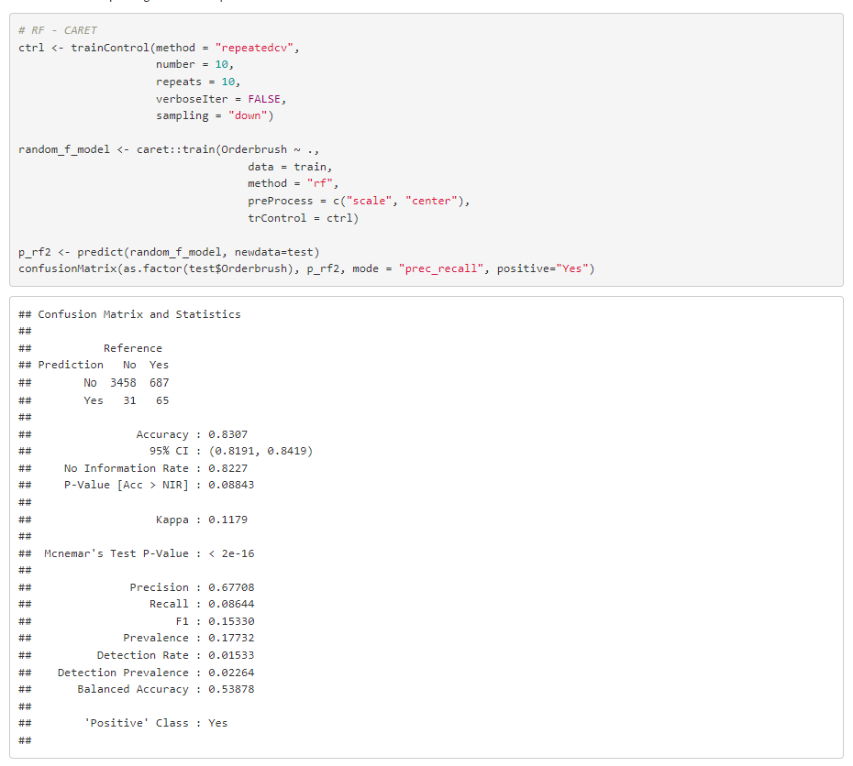
Random Forest: Model Accuracy
Cross validation: 10 fold With undersample and preprocessing
Notes:
#concatenate shopid and userid
orderBrush1 <- orderBrush
orderBrush1$shopid_userid <- paste(orderBrush1$shopid,orderBrush1$userid, sep = "")
#set event_time as date and time format
orderBrush1$event_time <- as.POSIXlt(orderBrush1$event_time)
#order the column shopid_userid by ascending order
orderBrush1 <- orderBrush1[order(orderBrush1$shopid_userid),]
#find duplicated shopid_userid
orderBrush1$duplicate <- duplicated(orderBrush1$shopid_userid) | duplicated(orderBrush1$shopid_userid, fromLast = TRUE)
#find those shopid_userid that with multiple orders place
orderBrush_multipleorder <- orderBrush1[orderBrush1$duplicate == TRUE,]
#find frequency of order for the shopid_userid
freq_orderBrush_multipleorder <- as.data.frame(table(orderBrush_multipleorder$shopid_userid))
colnames(freq_orderBrush_multipleorder) <- c("shopid_userid", "frequency")
orderBrush_multipleorder_freq <- merge(x = orderBrush_multipleorder, y = freq_orderBrush_multipleorder,
by = "shopid_userid")
#find those with more than 3 orders
orderBrush_multipleorder_freq <- orderBrush_multipleorder_freq[orderBrush_multipleorder_freq$frequency >= 3,]
#find the time different between each row (in seconds), assign zero to first row
orderBrush_multipleorder_freq$diff_time <- c(0, diff(orderBrush_multipleorder_freq$event_time))
#identify those order that place within an hour (3600 seconds)
#1 mean order place within an hour
#0 mean order place not wihitn an hour
for(i in 1:length(orderBrush_multipleorder_freq$diff_time)){
if( orderBrush_multipleorder_freq$diff_time[i] >= -3600 && orderBrush_multipleorder_freq$diff_time[i] <= 3600){
orderBrush_multipleorder_freq$brushing[i] <- 1
} else {
orderBrush_multipleorder_freq$brushing[i] <- 0
}
}
#only orders that being identify as brushing
orderBrush2 <- orderBrush_multipleorder_freq[orderBrush_multipleorder_freq$brushing == 1,]
#find the frequency of shopid_userid
freq_orderBrush2 <- as.data.frame(table(orderBrush2$shopid_userid))
colnames(freq_orderBrush2) <- c("shopid_userid", "frequency")
freq_orderBrush2 <- merge(x = orderBrush2, y = freq_orderBrush2,
by = "shopid_userid")
#find order with frequency more than equal to 2
#this is because those with frequency 1 should not be brushing
freq_orderBrush2 <- freq_orderBrush2[freq_orderBrush2$frequency.y >= 2,]
#total 743 group of order brushing
unique(freq_orderBrush2$shopid_userid)
#total 388 shops that suspect to have order brushing
unique(freq_orderBrush2$shopid)
#total 673 users that suspect to have order brushing
unique(freq_orderBrush2$userid)

Slide 63
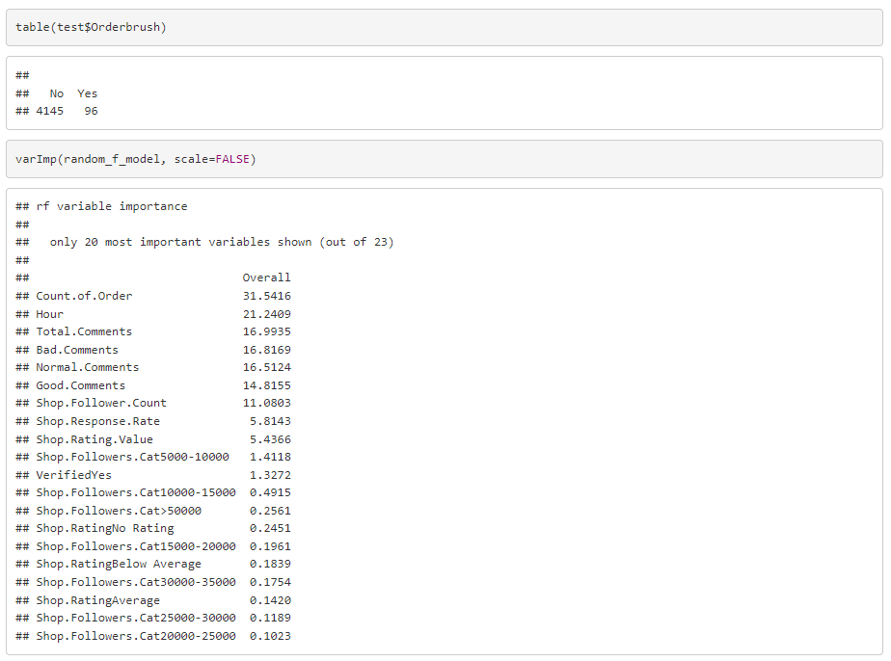
Random Forest: Model Accuracy
Notes:
#concatenate shopid and userid
orderBrush1 <- orderBrush
orderBrush1$shopid_userid <- paste(orderBrush1$shopid,orderBrush1$userid, sep = "")
#set event_time as date and time format
orderBrush1$event_time <- as.POSIXlt(orderBrush1$event_time)
#order the column shopid_userid by ascending order
orderBrush1 <- orderBrush1[order(orderBrush1$shopid_userid),]
#find duplicated shopid_userid
orderBrush1$duplicate <- duplicated(orderBrush1$shopid_userid) | duplicated(orderBrush1$shopid_userid, fromLast = TRUE)
#find those shopid_userid that with multiple orders place
orderBrush_multipleorder <- orderBrush1[orderBrush1$duplicate == TRUE,]
#find frequency of order for the shopid_userid
freq_orderBrush_multipleorder <- as.data.frame(table(orderBrush_multipleorder$shopid_userid))
colnames(freq_orderBrush_multipleorder) <- c("shopid_userid", "frequency")
orderBrush_multipleorder_freq <- merge(x = orderBrush_multipleorder, y = freq_orderBrush_multipleorder,
by = "shopid_userid")
#find those with more than 3 orders
orderBrush_multipleorder_freq <- orderBrush_multipleorder_freq[orderBrush_multipleorder_freq$frequency >= 3,]
#find the time different between each row (in seconds), assign zero to first row
orderBrush_multipleorder_freq$diff_time <- c(0, diff(orderBrush_multipleorder_freq$event_time))
#identify those order that place within an hour (3600 seconds)
#1 mean order place within an hour
#0 mean order place not wihitn an hour
for(i in 1:length(orderBrush_multipleorder_freq$diff_time)){
if( orderBrush_multipleorder_freq$diff_time[i] >= -3600 && orderBrush_multipleorder_freq$diff_time[i] <= 3600){
orderBrush_multipleorder_freq$brushing[i] <- 1
} else {
orderBrush_multipleorder_freq$brushing[i] <- 0
}
}
#only orders that being identify as brushing
orderBrush2 <- orderBrush_multipleorder_freq[orderBrush_multipleorder_freq$brushing == 1,]
#find the frequency of shopid_userid
freq_orderBrush2 <- as.data.frame(table(orderBrush2$shopid_userid))
colnames(freq_orderBrush2) <- c("shopid_userid", "frequency")
freq_orderBrush2 <- merge(x = orderBrush2, y = freq_orderBrush2,
by = "shopid_userid")
#find order with frequency more than equal to 2
#this is because those with frequency 1 should not be brushing
freq_orderBrush2 <- freq_orderBrush2[freq_orderBrush2$frequency.y >= 2,]
#total 743 group of order brushing
unique(freq_orderBrush2$shopid_userid)
#total 388 shops that suspect to have order brushing
unique(freq_orderBrush2$shopid)
#total 673 users that suspect to have order brushing
unique(freq_orderBrush2$userid)

Slide 64
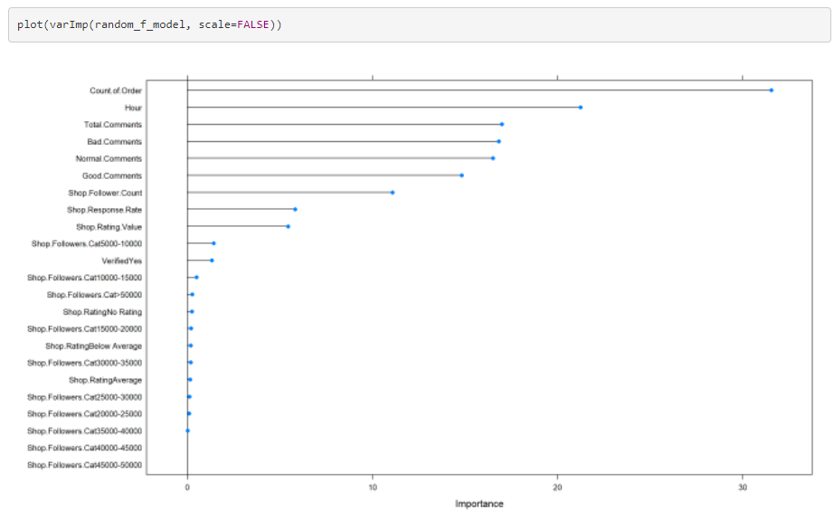
Random Forest: Model Accuracy
Notes:
#concatenate shopid and userid
orderBrush1 <- orderBrush
orderBrush1$shopid_userid <- paste(orderBrush1$shopid,orderBrush1$userid, sep = "")
#set event_time as date and time format
orderBrush1$event_time <- as.POSIXlt(orderBrush1$event_time)
#order the column shopid_userid by ascending order
orderBrush1 <- orderBrush1[order(orderBrush1$shopid_userid),]
#find duplicated shopid_userid
orderBrush1$duplicate <- duplicated(orderBrush1$shopid_userid) | duplicated(orderBrush1$shopid_userid, fromLast = TRUE)
#find those shopid_userid that with multiple orders place
orderBrush_multipleorder <- orderBrush1[orderBrush1$duplicate == TRUE,]
#find frequency of order for the shopid_userid
freq_orderBrush_multipleorder <- as.data.frame(table(orderBrush_multipleorder$shopid_userid))
colnames(freq_orderBrush_multipleorder) <- c("shopid_userid", "frequency")
orderBrush_multipleorder_freq <- merge(x = orderBrush_multipleorder, y = freq_orderBrush_multipleorder,
by = "shopid_userid")
#find those with more than 3 orders
orderBrush_multipleorder_freq <- orderBrush_multipleorder_freq[orderBrush_multipleorder_freq$frequency >= 3,]
#find the time different between each row (in seconds), assign zero to first row
orderBrush_multipleorder_freq$diff_time <- c(0, diff(orderBrush_multipleorder_freq$event_time))
#identify those order that place within an hour (3600 seconds)
#1 mean order place within an hour
#0 mean order place not wihitn an hour
for(i in 1:length(orderBrush_multipleorder_freq$diff_time)){
if( orderBrush_multipleorder_freq$diff_time[i] >= -3600 && orderBrush_multipleorder_freq$diff_time[i] <= 3600){
orderBrush_multipleorder_freq$brushing[i] <- 1
} else {
orderBrush_multipleorder_freq$brushing[i] <- 0
}
}
#only orders that being identify as brushing
orderBrush2 <- orderBrush_multipleorder_freq[orderBrush_multipleorder_freq$brushing == 1,]
#find the frequency of shopid_userid
freq_orderBrush2 <- as.data.frame(table(orderBrush2$shopid_userid))
colnames(freq_orderBrush2) <- c("shopid_userid", "frequency")
freq_orderBrush2 <- merge(x = orderBrush2, y = freq_orderBrush2,
by = "shopid_userid")
#find order with frequency more than equal to 2
#this is because those with frequency 1 should not be brushing
freq_orderBrush2 <- freq_orderBrush2[freq_orderBrush2$frequency.y >= 2,]
#total 743 group of order brushing
unique(freq_orderBrush2$shopid_userid)
#total 388 shops that suspect to have order brushing
unique(freq_orderBrush2$shopid)
#total 673 users that suspect to have order brushing
unique(freq_orderBrush2$userid)

Slide 65
Random Forest: Model Accuracy
Cross validation: 10 fold With undersample and Normalization preprocessing
Notes:
#concatenate shopid and userid
orderBrush1 <- orderBrush
orderBrush1$shopid_userid <- paste(orderBrush1$shopid,orderBrush1$userid, sep = "")
#set event_time as date and time format
orderBrush1$event_time <- as.POSIXlt(orderBrush1$event_time)
#order the column shopid_userid by ascending order
orderBrush1 <- orderBrush1[order(orderBrush1$shopid_userid),]
#find duplicated shopid_userid
orderBrush1$duplicate <- duplicated(orderBrush1$shopid_userid) | duplicated(orderBrush1$shopid_userid, fromLast = TRUE)
#find those shopid_userid that with multiple orders place
orderBrush_multipleorder <- orderBrush1[orderBrush1$duplicate == TRUE,]
#find frequency of order for the shopid_userid
freq_orderBrush_multipleorder <- as.data.frame(table(orderBrush_multipleorder$shopid_userid))
colnames(freq_orderBrush_multipleorder) <- c("shopid_userid", "frequency")
orderBrush_multipleorder_freq <- merge(x = orderBrush_multipleorder, y = freq_orderBrush_multipleorder,
by = "shopid_userid")
#find those with more than 3 orders
orderBrush_multipleorder_freq <- orderBrush_multipleorder_freq[orderBrush_multipleorder_freq$frequency >= 3,]
#find the time different between each row (in seconds), assign zero to first row
orderBrush_multipleorder_freq$diff_time <- c(0, diff(orderBrush_multipleorder_freq$event_time))
#identify those order that place within an hour (3600 seconds)
#1 mean order place within an hour
#0 mean order place not wihitn an hour
for(i in 1:length(orderBrush_multipleorder_freq$diff_time)){
if( orderBrush_multipleorder_freq$diff_time[i] >= -3600 && orderBrush_multipleorder_freq$diff_time[i] <= 3600){
orderBrush_multipleorder_freq$brushing[i] <- 1
} else {
orderBrush_multipleorder_freq$brushing[i] <- 0
}
}
#only orders that being identify as brushing
orderBrush2 <- orderBrush_multipleorder_freq[orderBrush_multipleorder_freq$brushing == 1,]
#find the frequency of shopid_userid
freq_orderBrush2 <- as.data.frame(table(orderBrush2$shopid_userid))
colnames(freq_orderBrush2) <- c("shopid_userid", "frequency")
freq_orderBrush2 <- merge(x = orderBrush2, y = freq_orderBrush2,
by = "shopid_userid")
#find order with frequency more than equal to 2
#this is because those with frequency 1 should not be brushing
freq_orderBrush2 <- freq_orderBrush2[freq_orderBrush2$frequency.y >= 2,]
#total 743 group of order brushing
unique(freq_orderBrush2$shopid_userid)
#total 388 shops that suspect to have order brushing
unique(freq_orderBrush2$shopid)
#total 673 users that suspect to have order brushing
unique(freq_orderBrush2$userid)

Slide 66
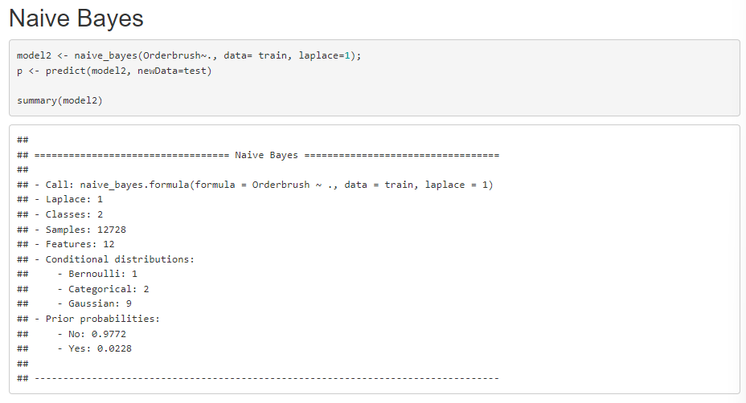
Naives Bayes

Slide 67
Model Comparison
Notes:
Describe the modeling techniques used (e.g. regression, classification,
clustering).
• Compare and contrast different modeling algorithms.
• Explain and discuss the experimental results.
• Discuss any limitations of the approach

Slide 68
Conclusion
Notes:
Discuss any learning points.
• Suggest possible future improvements

Slide 69
Notes:
Discuss any learning points.
• Suggest possible future improvements

Slide 70
References
Notes:
https://www.kaggle.com/datasets/davydev/shopee-code-league-20?resource=download

